Slide 1
MTN-016
Infant Visits

Slide 2
MTN-016: Inclusion/Exclusion
Infant Inclusion Criteria
Born to EMBRACE participant mother from pregnancy concurrent with participation in parent study.
Written informed consent by parent/guardian
Exclusion Criteria
Has reached 1 year birth date
IoR discretion
Notes:
Mother MUST be enrolled for infant to be enrolled.

Slide 3
Question
If the mother decides not to enroll into MTN-016 but is willing to bring in her baby for all infant visits after birth, is the infant enrolled?
No. Infants are only eligible to join EMBRACE if their mothers are enrolled. Remember, women may enroll in the trial without consenting to their infant’s participation.

Slide 4
Visit Schedule:
Infant visit schedule is determined by date of birth:
Newborn/Initial Visit (within 10 days of birth)
Month 1 (+/- 2 weeks)
Month 6 (+/- 1 month)
Month 12 (+/- 1 month)
Interim visits, as needed

Slide 5
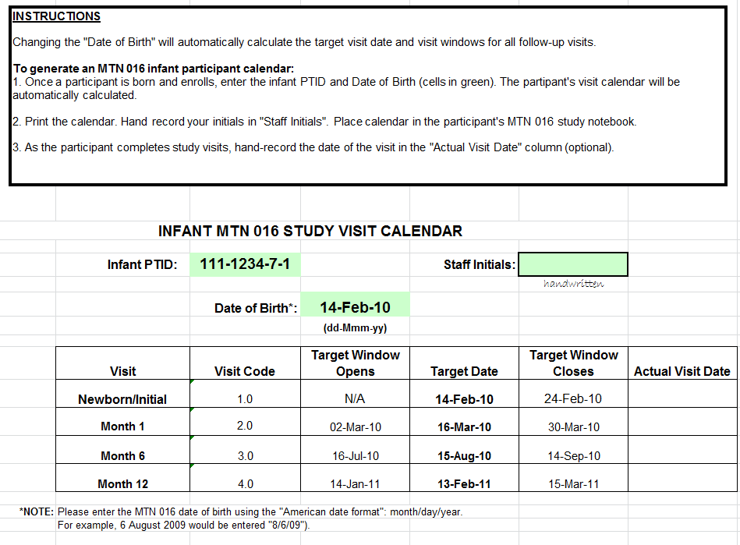
Notes:
May occur on ASPIRE visit days, is mother still in parent protocol follow-up. Site to discuss pros/cons of same day visits.
SCHARP will review visit windows in more detail during the data management training.

Slide 6
Newborn/Initial Visit
Completed within 10 days of birth
May be conducted on same day as pregnancy outcome data is collected for mother
When will your site talk about this visit with women in MTN-016?
How will birth records be obtained?
Like other MTN-016 visits, may occur off site, if mother agrees.
Remember to confirm infant consent has been given prior to conducting any study assessments.

Slide 7
Newborn/Initial Visit
If the first visit with an infant occurs at month 1, 6, or 12 visit, conduct the follow-up procedures plus the Enrollment CRF and Missed Visit CRFs for any visits not conducted. Do not repeat procedures within the visit window.

Slide 8
Newborn/Initial Visit Procedures
Confirm or Obtain Informed Consent
Eligibility assessment
Infant PTID assignment
Collect Locator Information (can be same as mother, but should be updated at infant visits)
Collect Medical History
Collect Medication History
Physical Exam
As Indicated:
Major Malformation Assessment Worksheet
Photographic Documentation
Social Harms Assessment
Infant HIV testing
Reimbursement, Schedule next visit

Slide 9
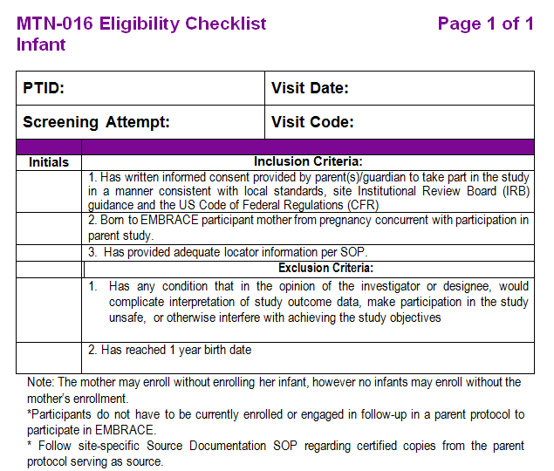
Eligibility Documentation - Infant
If an eligibility checklist tool is not used, all inclusion/exclusion criteria must be clearly documented in the chart notes.

Slide 10
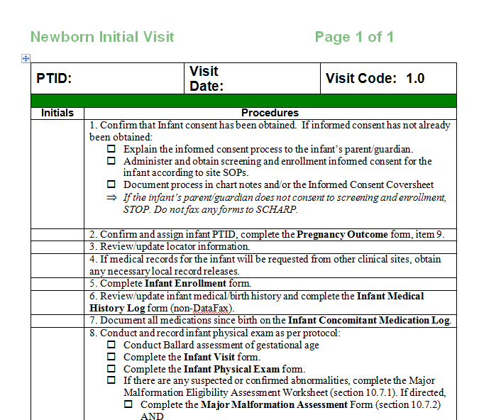
Newborn Initial Visit Checklist

Slide 11
Medical & Medication History
Collected or updated at each infant visit
Medical conditions diagnosed by a clinician and symptoms/conditions reported by the mother should be included
Vaccinations do not get recorded on the ConMeds log; there is a separate CRF for this
Notes:
SCHARP will review CRFs in more detail during data training

Slide 12
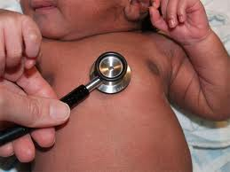
Physical Exam
Components of infant exam detailed in Protocol Appendix III:
Growth parameters (includes length, weight, head circumference, and abdominal circumference at M1)
General appearance
Detailed examination, paying specific attention to any major malformations
The presence of one anomaly should raise suspicion that there are more.
Notes:
Assessment of Major malformations to be discussed later.
Growth parameters over first year…try to use the same equipment

Slide 13
Infant Exam Training Videos
http://www.med.umich.edu/medstudents/curRes/M3/peds/index.html
All staff responsible for conducting infant exams on the Delegation of Authority log must view and file documentation of viewing the physical exam training videos available here.
Notes:
Can watch videos together during the training or at the end of the day, if there is extra time.

Slide 14
Assessing Infant Growth
Use WHO growth charts posted on MTN website
Plot growth at each visit.
Positions of the individual points on the graph are less important than the overall trajectory of the growth curve over time.
Additional follow-up may be warranted if:
Sharp upwards or downwards trend over a short period of time (crosses one percentile curve/may be close to crossing a second)
Growth at <2nd percentile or >98th percentile
Consistent flat growth trend
Concerns such as poor nutritional intake, presence of a chronic illness, etc.

Slide 15
Assessing Infant Growth
Notes:
1st line: normal growth. Infant’s growth trajectory follows 50th percentile line.
2nd line (first half): Concerning growth. Infant born at 50th percentile weight, but by 4 months of age, has crossed several percentile lines. Need to intervene. Ideal intervention would have been at M1, as infant was already showing signs of poor growth.
2nd line (second half): Shows infant’s growth after intervention. Note infant does not “make up” growth back to 50th percentile line, but begins following a different growth curve, still along healthy trajectory.

Slide 16
Infant Months 1, 6, & 12
Visit Procedures

Slide 17
Infant Follow-Up Visit Procedures
Update Locator
Update Medical History
Update Medication History
Clinical Procedures:
Physical Exam
As Indicated:
Major Malformation Assessment
Photographic Documentation
Social Harms Assessment
Infant HIV testing
Schedule next visit
Reimbursement
Notes:
These procedures are almost identical to the newborn/initial visit procedures, just updating information at these visits.

Slide 18
Infant: Months 1, 6 and 12
Remember:
Month 1
Visit window is +/- 2 weeks
Months 6 and 12
Visit windows are +/- 1 month

Slide 19
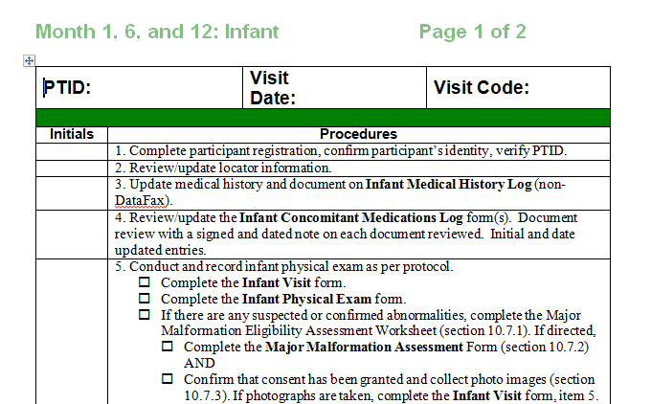

Slide 20
Additional Procedures at M12
Month 12 is the infant’s final visit for MTN-016. In addition to the regular follow-up documentation, complete:
Infant Termination CRF
Infant End of Study Inventory
If the infant misses the month 12 visit, complete these forms when the window closes.
Notes:
SCHARP will review again/in more detail during data management training.

Slide 21
Interim Visits - Infant
Potential reasons for an interim visit:
Follow-up on previous abnormal finding
Infant reports to clinic with clinical signs/symptoms that need to be followed
HIV testing/follow-up conducted for HIV-exposed or HIV-infected infant
A social harm is reported
Notes:
Prompt the audience to think of potential reasons for infant interim visits.
Note that there may be other valid reasons that the sites think of that are not listed here.
Photographic documentation of suspected or confirmed abnormal findings—this would be a split visit? Confirm w/ Corey

Slide 22
Interim Visit Procedures
Update Locator
Update Medical History
Update Medication History
As Indicated:
Photographic Documentation
Physical Exam
Social Harms Assessment
Infant HIV testing and/or additional laboratory testing to follow previous abnormal finding
Schedule next visit
Reimbursement
Notes:
Same as a M1,6,12 visit, but clinical procedures only if indicated

Slide 23
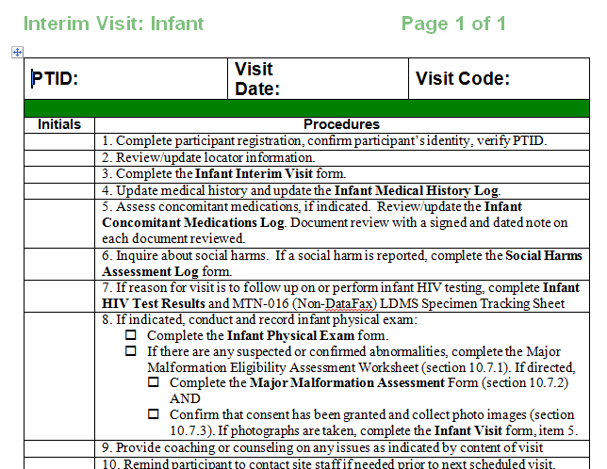

Slide 24
Infant Visit Scenario 1
Mercy and her infant have just completed the MTN-016 newborn initial visit; her infant is happy and healthy.
Mercy’s next scheduled ASPIRE visit is on her target date,18 June 2014; her infant participant calendar is as follows:
Visit | Target Window Opens | Target Date | Target Window Closes
Month 1 | 17-May-14 | 31-May-14 | 14-Jun-14

Slide 25
Next target/scheduled ASPIRE visit is on 18 June 2014. Infant visit calendar shows:
What might you need to take into consideration when scheduling the infant exam?
Visit | Target Window Opens | Target Date | Target Window Closes
Month 1 | 17-May-14 | 31-May-14 | 14-Jun-14
Notes:
What might you take into consideration regarding the scheduling the M1 infant visit?
Availability of MTN-016 staff; type of visit procedures to be done at M1
Should Mercy’s ASPIRE visit be rescheduled to earlier in the visit window or should the visits remain separate?

Slide 26
Infant Visit Scenario 2
Flavia and her infant have an uneventful MTN-016 Month 1 visit, the baby is happy and well.
At a subsequent ASPIRE visit, Flavia brings her now 4 month old infant, who she thinks has a fever.

Slide 27
Infant Visit Scenario 2
Should this be an MTN-016 visit? If so, what type and what procedures need to be done?
Too early for the 6 month visit window, but an interim visit could be conducted, per clinical discretion.
Consider availability of clinician designated for MTN-016 infant exams.
Update medical and medication history as needed, infant physical exam form. Referral for additional care, if needed.

Slide 28
Infant Visit Scenario 3
Sarah returned to her home village to deliver her baby.
When she reappeared at the MTN-016 clinic, her baby was a month old.

Slide 29
Infant Visit Scenario 3
Which infant procedures should be conducted?
Since infant is within the M1 visit window, conduct the M1 procedures. Note that the Enrollment CRF and a Missed Visit CRF for the newborn/initial visit also need to be completed.
Which visit will you schedule next?
If all is well, the next visit will be the M6 visit.
Notes:
Note that the Enrollment CRF also needs to be completed and a Missed Visit CRF should be filled out since the newborn/initial visit was missed.

Slide 30
Questions?

